Slide 1
Upcoming Opportunities
Amy Holman
Regional Coordinator
Alaska Infrastructure Development Symposium
April 4, 2024
Notes:
Previous identity has proved to be overly complex to apply, reducing buy-in. The old brand guide did not perform well in the difficult balancing act between consistency and sameness.
This presentation introduces branding goals and outlines proposed changes to the brand standards guide.

Slide 2
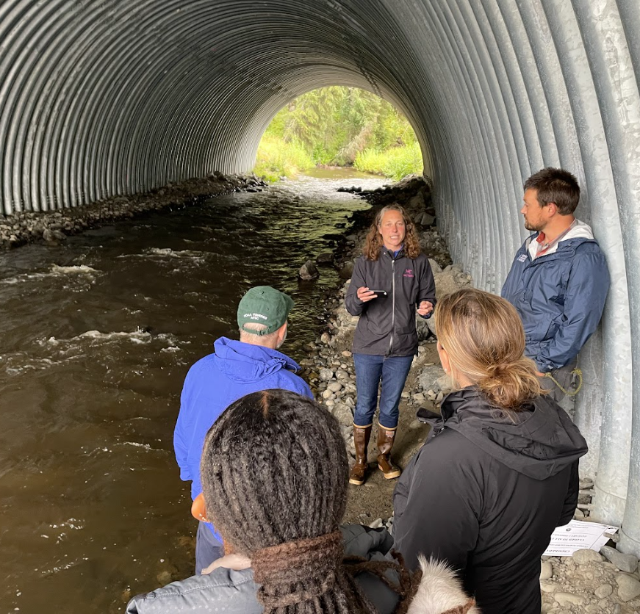
Bipartisan Infrastructure Law (BIL) Summary
Climate Ready Coasts
Program | Upcoming Awards? | New Funding Opportunities?
Transformational Habitat Restoration Grants | ✅
Habitat Restoration for Tribes and Underserved Communities | ✅
Fish Passage | ✅
Tribal Fish Passage | ✅

Slide 3
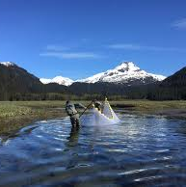
Bipartisan Infrastructure Law (BIL) Summary
Climate Ready Coasts
Program | Upcoming Awards? | New Funding Opportunities?
National Coastal Resilience Fund | ✅¹ | ✅
National Estuarine Research Reserves |  | ✅

Slide 4
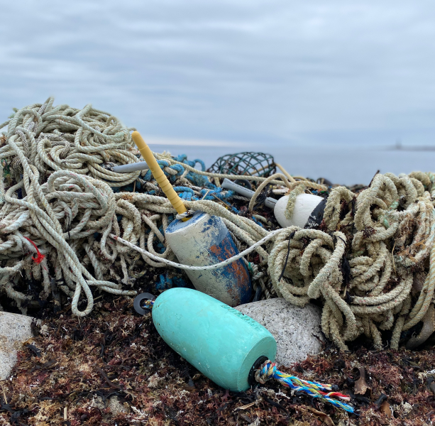
Bipartisan Infrastructure Law (BIL) Summary
Climate Ready Coasts
Program | Upcoming Awards? | New Funding Opportunities?
Marine Debris: Marine Debris Program project funding | ✅ | ✅¹
Merbok Impact Area |  | ✅²
Marine Debris: Sea Grant Marine Debris Challenge Competition | ✅ | ✅¹
Marine Debris: Sea Grant Marine Debris Community Action Coalitions | ✅ | ✅¹

Slide 5
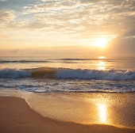
Bipartisan Infrastructure Law (BIL) Summary
Climate Data & Services
Program | Upcoming Awards? | New Funding Opportunities?
Regional Ocean Partnerships & Tribal Engagement | ✅ | ✅^{T}

Slide 6
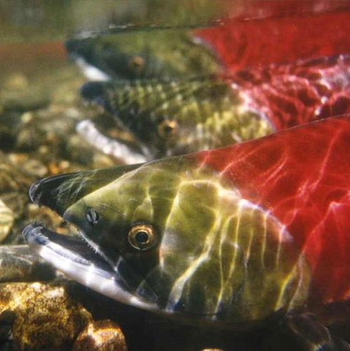
Bipartisan Infrastructure Law (BIL) Summary
Fisheries & Protected Resources
Program | Upcoming Awards? | New Funding Opportunities?
Pacific Coastal Salmon Recovery Fund | ✅

Slide 7
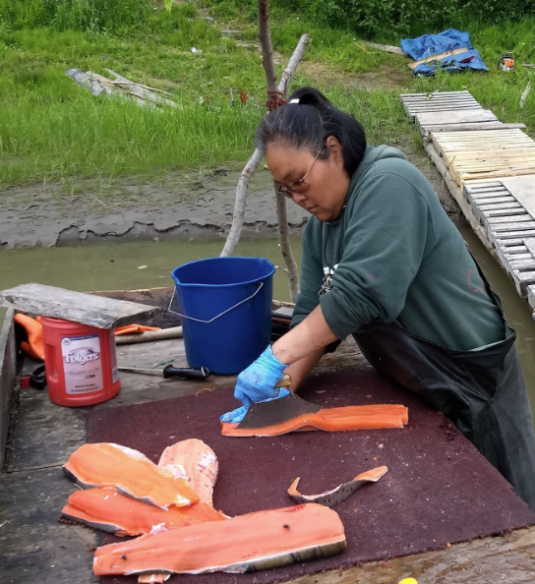
Inflation Reduction Act (IRA) Summary
Climate Ready Coasts & Communities
Program | Upcoming Awards? | New Funding Opportunities?
Climate Resilience Regional Challenge | ✅
Climate Ready Fisheries | ✅
Climate Ready Workforce | ✅
Tribal Priorities | ✅ | ✅
Notes:
CRRC: May notification to awardees; June announcement ref: Jaci Overbeck

